Slide 1



PRESENTED BY
DREAM TEAM
Is the movie a
HIT OR FLOP?

Slide 2



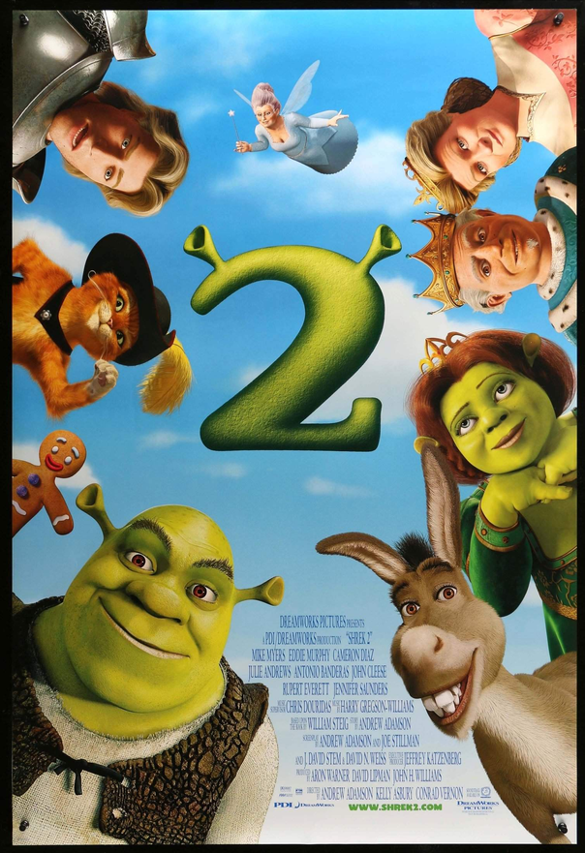

DREAM TEAM
THINK ABOUT YOUR FAVORITE MOVIE
How do you think your favorite movie did?

Slide 3
DREAM TEAM
WHY SHOULD WE PREDICT THE SUCCESS OF MOVIES?
When a movie is produced, it takes resources, and it can become expensive/ risky
Production businesses want to be able to reduce the losses they may have and maximize Return on investment
Predictive models help
make budget decisions
perform better release strategy
streaming platforms to identify which genres attract the biggest audience
predict churn-reducing titles

Slide 4



DREAM TEAM
Objective
BUILD A MACHINE LEARNING MODEL THAT PREDICTS WHETHER A MOVIE WILL BE A HIT OR FLOP BASED ON KEY FEATURES
Our Mission
We aim to look at which factors influence success in a movie and evaluate model performance.

Slide 5

DREAM TEAM
About
names | the movie’s title (English release names)
date_x | movie’s release date
score | movie’s rating score
genre | a list of the movie’s genres, seperated by commas
overview | a short description or plot summary of the movie
crew | names of key people involved (directors, writers, main cast)
orig_title | the original movie title
status | the film’s release status
orig_lang | movie’s original language
budget_x | movie’s production budget in USD
revenue | total worldwide box-office revenue in USD
country | country where movie info was collected from
OUR DATASET
Derived from Kaggle
10,178 rows of movies
12 features
the features have categorical, numerical, and text types

Slide 6
DREAM TEAM
How we cleaned our data
CLEANING DATASET
Issues encountered with Dataset
Total of 85 missing values in ‘genre’
Total of 56 missing values in ‘crew’
Cleaning Dataset
Categorical feautures such as genre, director, and country were converted into numerical values
made sure there were no nulls
created a variable hit or flop
after labeling, revenue was dropped

Slide 7
DREAM TEAM
How we built our
DECISION TREE
We had to manually code our target variable, these are the parameters we used.
DEPENDENT VARIABLE
HIT → revenue > budget
FLOP → revenue ≤ budget
budget_x
score
genre
actor_count
FEATURES USED IN
DECISION TREE
orig_land
country
director

Slide 8
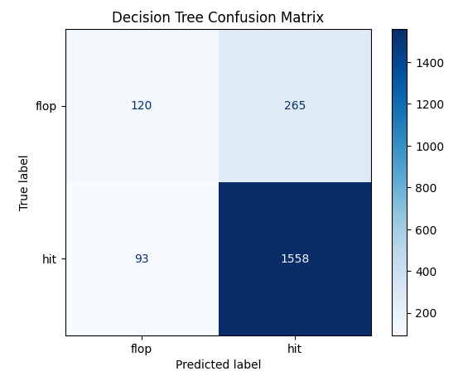
DREAM TEAM
Decision Tree
CONFUSION MATRIX +RESULTS
Train accuracy: 85%
Test accuracy: 82%
As you can see, our model is performing well. Our decision tree achieves 82% accuracy. It predicts hits well but does struggle a bit with flops due to imbalance.

Slide 9
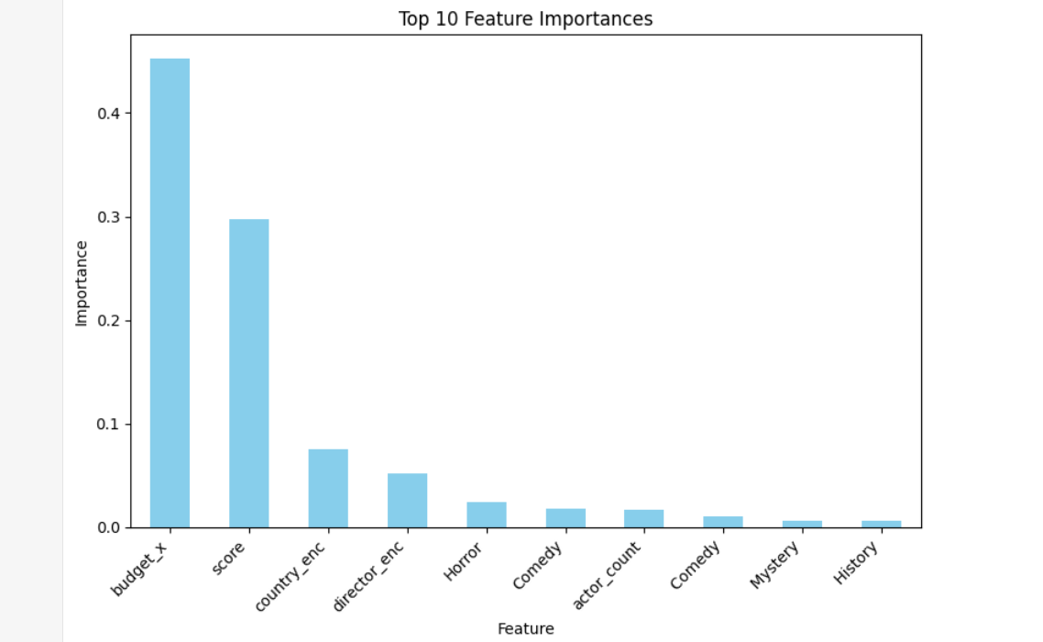
DREAM TEAM
Decision Tree
FEATURE IMPORTANCE
Budget and score are the strongest predictors in movie success aka making it a ‘Hit’

Slide 10
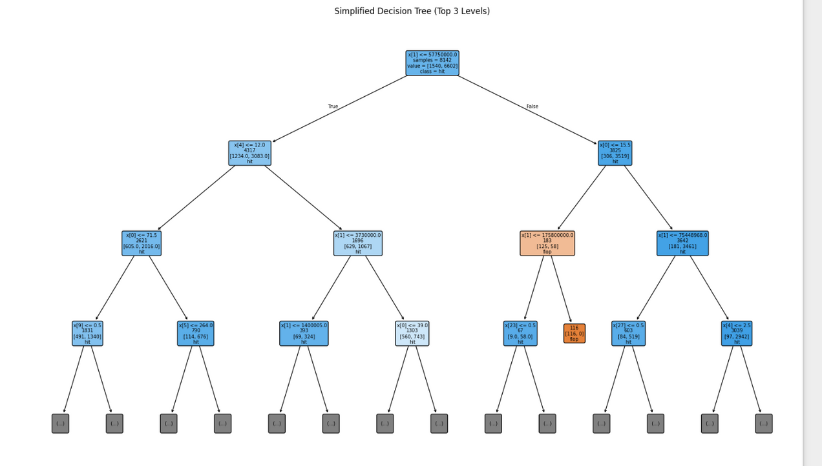
DREAM TEAM
Decision Tree
VISUALIZATION
The first split is : Budget
High budgets tend to have ‘Hit’
Low budget varies; it depends on
Score
Genre
Director
Country

Slide 11



DREAM TEAM
Let’’s play a game
GUESS IF THE MOVIE IS A HIT OR FLOP

Slide 12

DREAM TEAM
TURNING RED
MODEL SAYS:
HIT

Slide 13

DREAM TEAM
THE JUNGLE BOOK
MODEL SAYS:
FLOP

Slide 14

DREAM TEAM
THE HOUSEMAID
MODEL PREDICTS:
HIT

Slide 15

DREAM TEAM
FIVE NIGHTS AT FREDDY’S 2
MODEL PREDICTS:
HIT

Slide 16
DREAM TEAM
RECOMMENDATIONS
Increase budgets for movies that have promising success
Focus on movies that have an early high score
Avoid investing in films that fall in the low-budget and low score category, these tend to flop

Slide 17
DREAM TEAM
LIMITATIONS
01
Dataset has a mix of data types, so we had to limit our features a lot. In the real world, a movie success is based on more features.
04
No external market factors were included like social media buzz, fanbase size, etc.
02
The “Score” variable does not exist for a lot of new movies. We had to input a medium score for new movies but this introduces human-bias.
05
There is class imbalance with Hits = 82% and Flops =18% , which reduces flop recall
03
Dataset may not reflect current trends. Movies in different time periods have different trends.
06
The target variable is only on profit and does not include return on investment or audience sentiment

Slide 18

DREAM TEAM
In the end, our model shows that predicting movie success isn’t magic, it’s math. Thank you for watching as we brought data science to the big screen.
Thank you

Slide 19
SOURCES
Associate Vice President, Analytics & Data Strategy. (2024, July 3). Predictive analytics in movies: Using big data to forecast film success. Quantzig. https://www.quantzig.com/blog/predicting-movie-success-data-analytics-film-industry/
Singh, A. (2023). IMDb Movies Dataset [Data set]. Kaggle. https://www.kaggle.com/datasets/ashpalsingh1525/imdb-movies-dataset
Zhang, Z., [et al.]. (2024). Prediction techniques of movie box office using neural networks and emotional mining. Scientific Reports, 14(1).
https://doi.org/10.1038/s41598-024-72340-z

